Slide 1
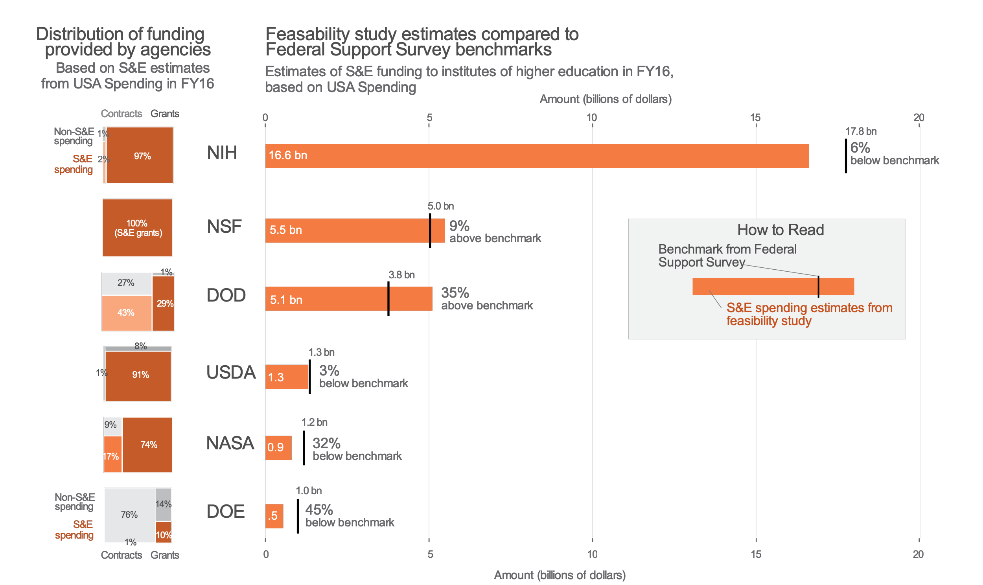

Measuring the public funding of R&d:
A feasibility study
DSPG Team: Sean Pietrowicz (University of Notre Dame), Alyssa Fowers (University of Miami)
SDAD Team: Samantha Cohen, Joel Thurston, Stephanie Shipp
Sponsor: John Jankowski, Chris Pece, Gary Anderson, Audrey Kindlon, NCSES
Can we estimate government spending on research and development using publicly available administrative data?
Research and Development (R&D) is basic and applied research and technological development. R&D is a subset of Science and Engineering (S&E), which also includes training, conferences, and fellowships.
We examined spending from 6 federal agencies in fiscal year 2016 to determine the feasibility of identifying transactions related to S&E and R&D. These 6 agencies (DOD, DOE, USDA, NASA, NIH, NSF) accounted for 97% of all R&D funding in the 2016 fiscal year.
Methods: Identifying Science and Engineering funding in USA Spending
Data Source: USA Spending
Maintained by Treasury Department, Bureau of the Fiscal Service since 2008
Dataset includes all transactions between federal government and institutions of higher education in FY 2016
174,377 grant-related transactions
126,617 contract-related transactions
Catalog of Federal Domestic Assistance (CFDA) numbers explain intended use of grants. CFDA codes could identify S&E, but not specifically R&D.
Benchmarking: The Federal Support Survey (FSS)
The Survey of Federal Science and Engineering Support to Universities, Colleges, and Nonprofit Institutions (FSS) is run by the NCSES
Yearly census of R&D and S&E funding; used FY 2016 data in analysis
Product & Service Codes (PSC) classify contracts by purpose (including R&D)
Results
Checking Our Work
Conclusions
Yes, it is feasible to estimate R&D spending with publicly available data. Using project funding indicators in USA Spending, we produced estimates of S&E funding similar to those in the FSS.
Future Work
Refine and measure subtypes of S&E and R&D
Use additional microdata, e.g. abstracts, to assess whether basic, applied, and development research can be identified
Examine agency-specific databases to fill in additional information beyond USA Spending
Federal RePORTER is an NIH-run public database of R&D funding: accurate, but not comprehensive
Used as a sample of R&D grants to test accuracy of our classification method
Result:
The Classification method
identified 99.9% of the
R&D grants found in
Federal RePORTER.
Identified as S&E in
USA Spending
No Yes
Found in Federal Reporter
Yes No
69,932 | 19,252
93 | 3759

